Slide 1
The Hydrologic Cycle

Slide 2
The Hydrologic Cycle

Slide 3
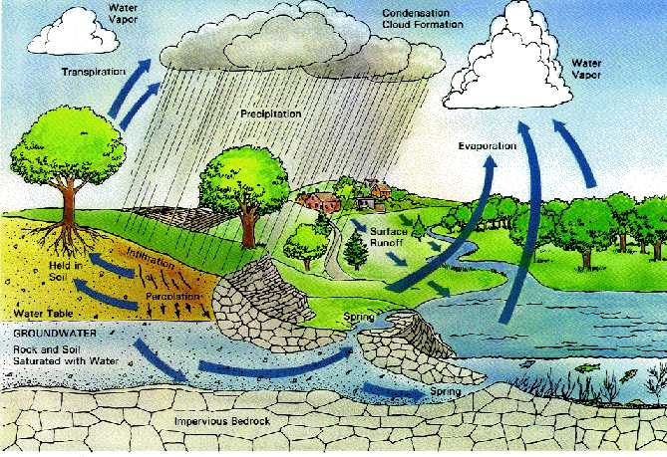
The Hydrologic Cycle

Slide 4
General Topics
Evaporation
Transpiration
Condensation
Precipitation – interception, infiltration, depression storage, Overland Flow
Stream Hydrographs
Rainfal-Runoff
Storm Duration Curves
Determining Groundwater Recharge
Measurement of Streamflow
Evapotranspiration

Slide 5
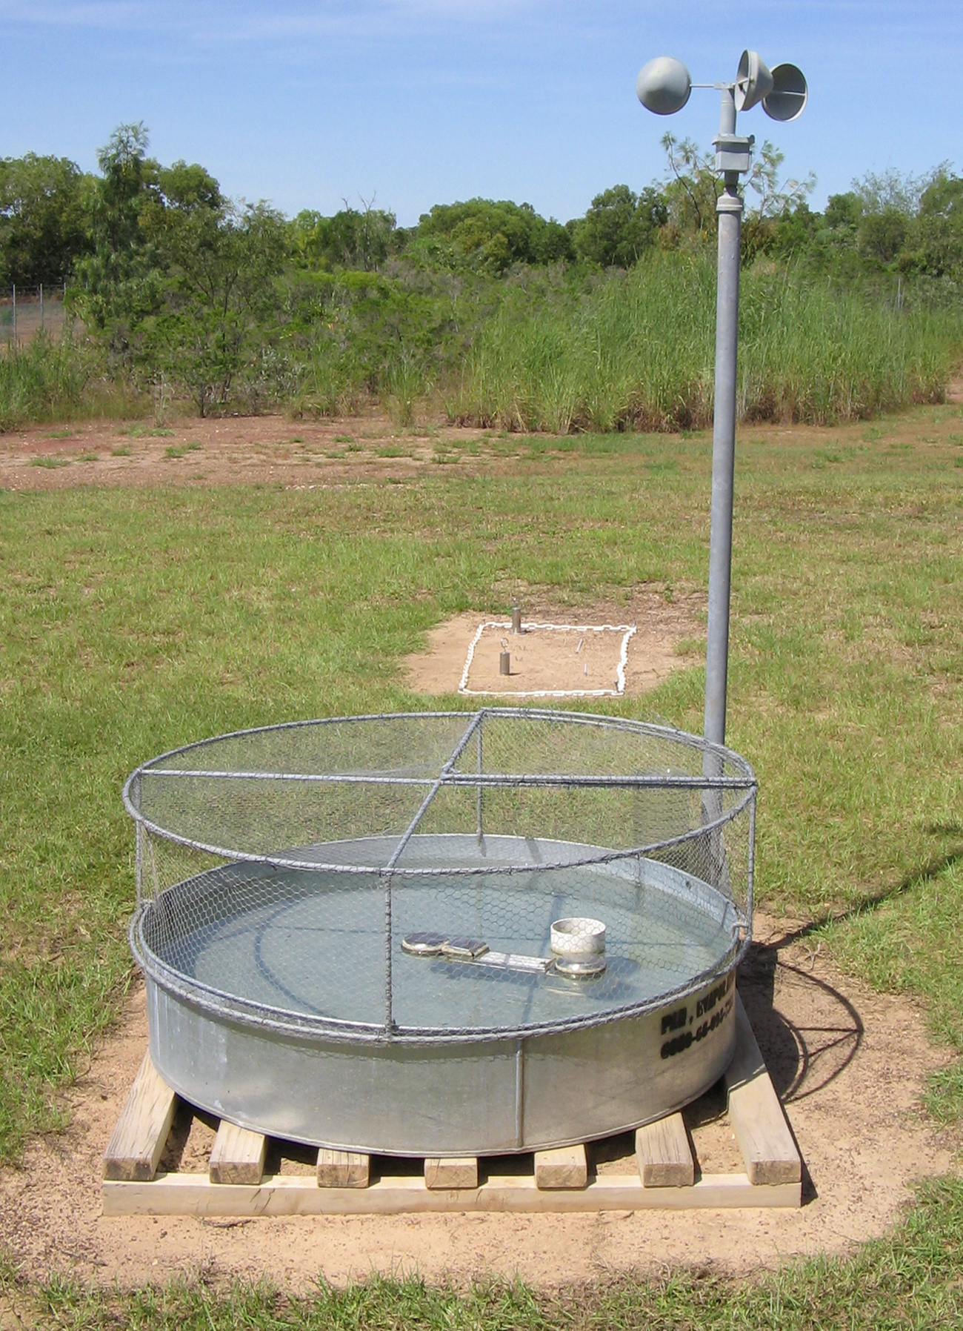
Evaporation
Questions : How to measure it?
Mass Balance – account for al flows in, all flows out
Land Pan (4ft diameter, 10 inches deep unpainted gaavnised metal) – about 450 deployed across USA
Daily records of depth of water, precipitation, replacement water and wind record – empirical relationships

Slide 6
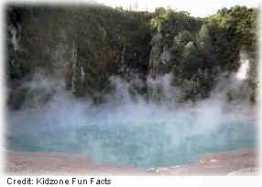
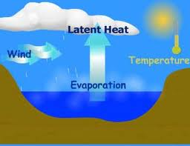
Evaporation
Problems
Averages (One daily/weekly/monthly vs. Continuous)
Highly variable depending on conditions
What does a pan tell us about say something the size of a lake?
Empirical Corrections – EMPIRICAL!!
Works well in lab where conditions are well controlled, but real life is not so simple

Slide 7
Penman Formula (Semi-Empirical)
While there are many variants for this formula (which you may have seen in Environmental Hydrology), here I provide only one
H_{w} – Evaporation [mm/day]
E_{n} – net radiation [mm/day]
E_{ao} – mass transfer [mm/day]
Δ [mm Hg/ºC] – slope of the saturation vapor pressure curve at mean temperature
α – psychometric constant (0.49 mm Hg/ºC)
Penman’s equation is built on theoretical reasoning by combining energy-balance and mass-transfer approach.

Slide 8
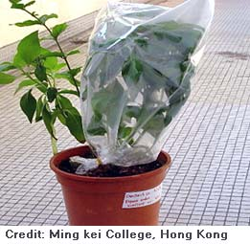
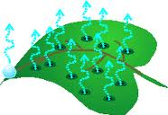
Transpiration
Transpiration is the process by which moisture is carried through plants from roots to small pores on the underside of leaves, where it changes to vapor and is released to the atmosphere.
Transpiration is essentially evaporation of water from plant leaves.
Studies have revealed that about 10 percent of the moisture found in the atmosphere is released by plants through transpiration.

Slide 9
Transpiration
How much water do plants transpire?
During a growing season, a leaf will transpire many times more water than its own weight. An acre of corn gives off about 3,000-4,000 gallons (11,400-15,100 liters) of water each day, and a large oak tree can transpire 40,000 gallons (151,000 liters) per year.
Very season, daytime. climate and vegetation dependent
Question to the Audience: Urban vs. Rural?

Slide 10
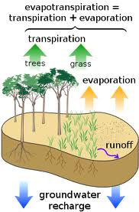
Evapotranspiration
In the field it is next to impossible to distinguish between evaporation and transpiration so we lump them together. From a water budget perspective we don’t care too much about the details

Slide 11
Evapotranspiration
Potential evapotranspiration (PET) is the amount of water that could be evaporated and transpired if there were sufficient water available.
Actual Transpiration (AET) is the amount that actually occurs because there is a deficiency of water.
During summer months PET is highest, but so is the potential for water shortage

Slide 12
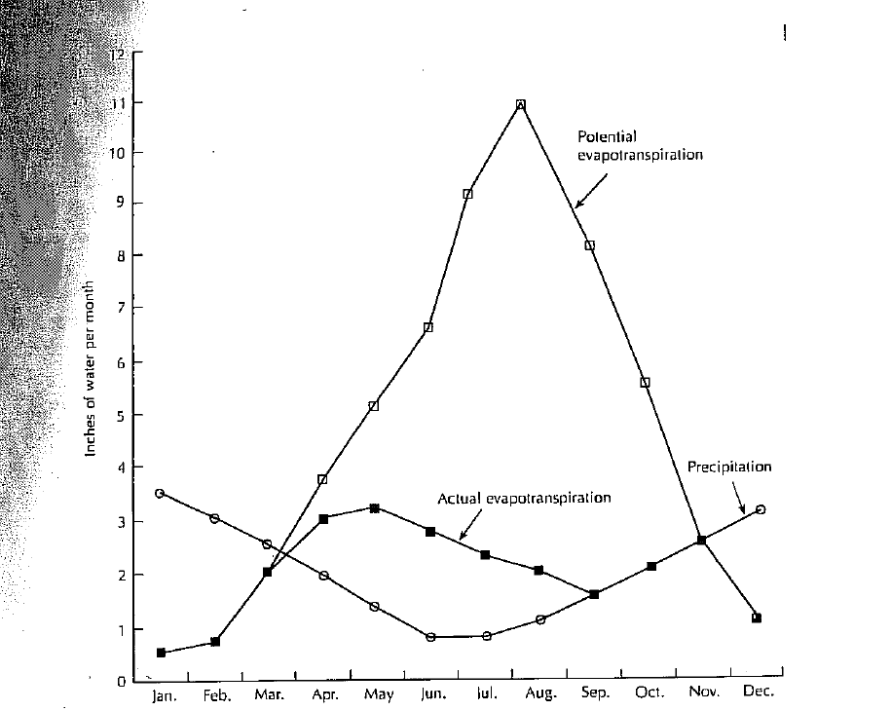
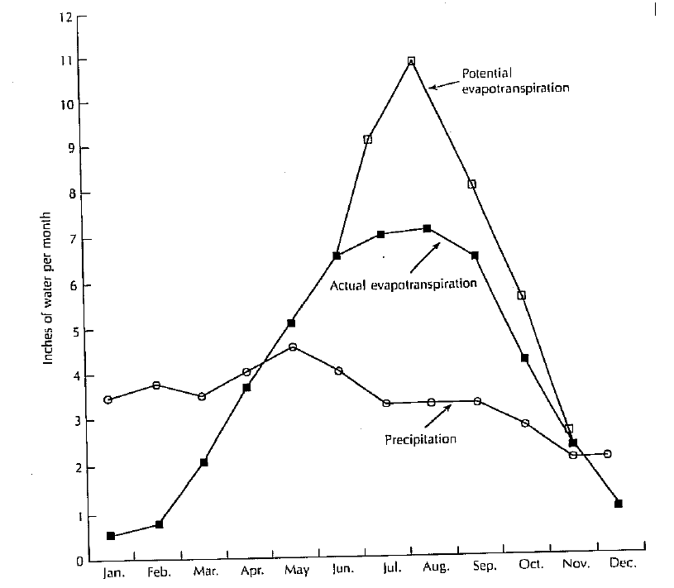
PET vs AET
Diagrams of potential and actual evapotranspiration
one in a coarse soil with limited moisture storage; warm, dry summers and cool, moist winters
A fine soil with ample soil-moisture storage, warm summers, cool winters and little seasonal variation in precipitation

Slide 13
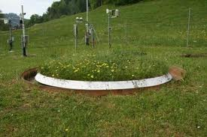
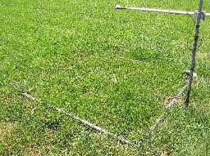
Measuring Evapotranspiration
Lysimeter – a large container holding soil and plants. Mass Balance:
Debate: Pros/Cons

Slide 14
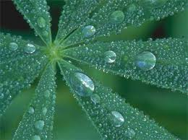
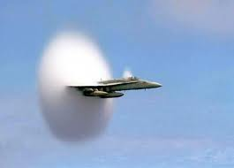
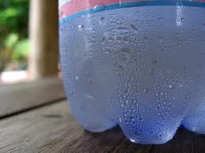
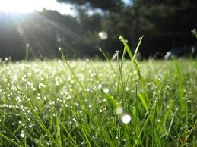
Condensation
Condensation is the change of the physical state of matter from gaseous phase into liquid phase, and is the reverse of evaporation

Slide 15

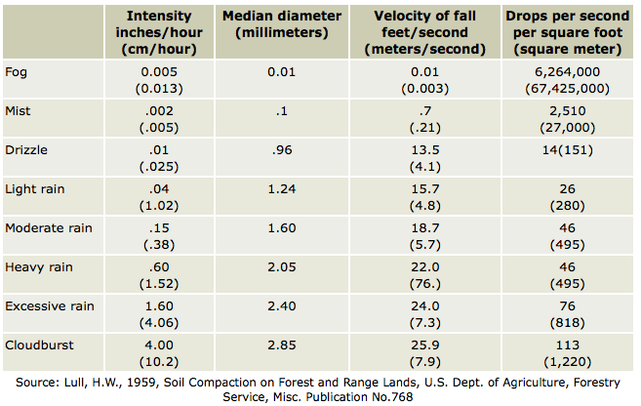
Precipitation
Precipitation is water released from clouds in the form of rain, freezing rain, sleet, snow, or hail. It is the primary connection in the water cycle that provides for the delivery of atmospheric water to the Earth. Most precipitation falls as rain.

Slide 16
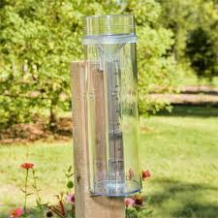
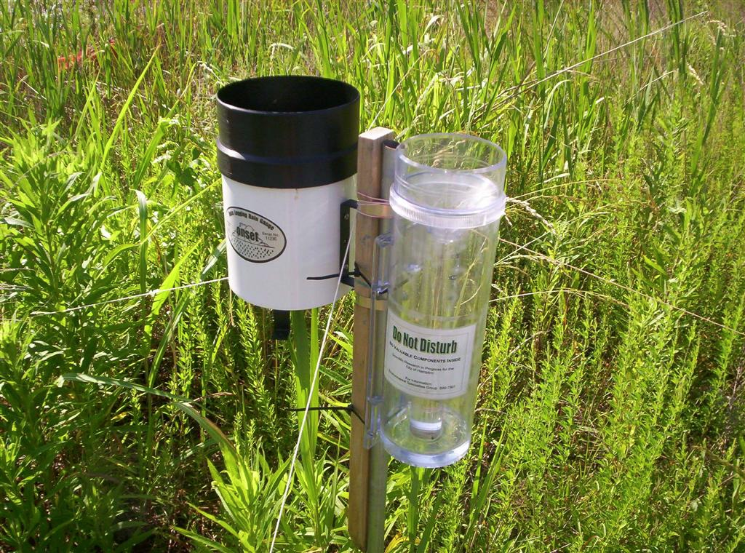
Measuring Precipitation
As long as the gauge is >3 cm diameter any size gauge should work
US standard – 20cm diameter (8 inches); Canada – 9 cm
Read once daily normally
Problems: wind/location – place as close to ground as possible, away from trees and buildings, but not too exposed to wind (low brush helps), level ground, sensitive to wind for snow/light rain

Slide 17
Getting Data
In the USA roughly 13500 reporting precipitation stations
NOAA : http://water.weather.gov/ahps/
http://www.ncdc.noaa.gov/oa/climate/stationlocator.html
http://www7.ncdc.noaa.gov/CDO/cdo

Slide 18
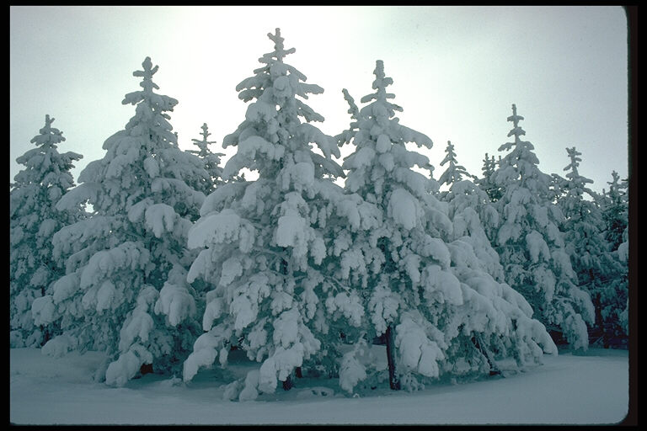

Events during Precipitation
Interception – vegetation can intercept rainfall and delay or prevent water reaching the ground – typically exponential in time
In dense forests can be 8-35% of annual precipitation
When storage capacity exceeded – stem flow

Slide 19
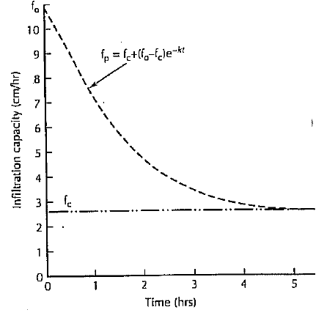
Events during Precipitation - Infiltration
Not all water that falls will reach the water table
Infiltration Capacity is measure of a soils capacity to absorb water
Highly variable – soil type, but also the same soil varies depending on current moisture content
Horton Infiltration Capacity Equation
Why does infiltration capacity reduce over time? What is the physical reason?
Will a coarse or a fine soil have a greater initial infiltration capacity? Final capacity? Explain

Slide 20
Infiltration Capacity
What actually infiltrates during precipitation?
Consider the infiltration curve and now draw precipitation on top of it. How much infiltrates (board)
Note: This is far from a perfect model and better ones do exist that you have learned about in Environmental Hydrology (e.g. Green-Ampt). Here I want you to simply be exposed to one such model.

Slide 21
Sample Problem
Consider an infiltration capacity curve with the following parameters:
f_{c}=10mm/hr; f_{o}=120mm/hr;k=1/2 hr⁻¹
How long does it take for the infiltration capacity to reduce to 10% of its initial value?
If there is a rainstorm of 25mm/hr that lasts 5 hours how much water infiltrates over an area of 100km^2?
If there is a rainstorm of 25mm/hr for the first hour, 10mm/hr for the next two and then 50mm/hr for the final 2how much water infiltrates over the same area?
Finally, what if it falls as 50mm/hr for the first hour, 25mm/hr for the next two and then 10mm/hour for the last 2 hours?

Slide 22
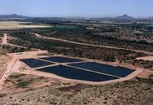
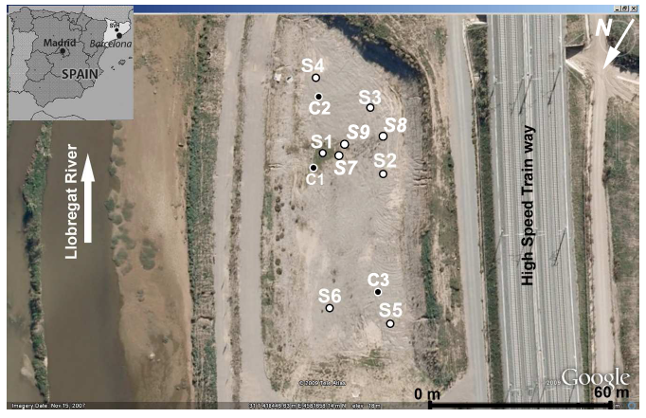
Practical Consideration – Artificial Recharge

Slide 23
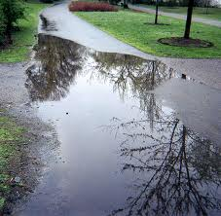
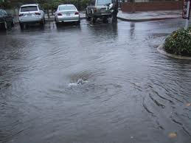
So what happens when infiltration capacity is exceeded?
Depression Storage
(Puddles etc)
When depression storage is exceeded Horton Overland Flow occurs - common in arid and semi-arid regions, where rainfall intensities are high and the infiltration capacity is reduced because of surface sealing, or in paved urban areas.

Slide 24
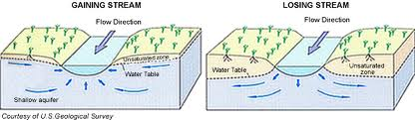
Streams and Groundwater Gaining vs Losing
How do you determine which it is? – Groups

Slide 25
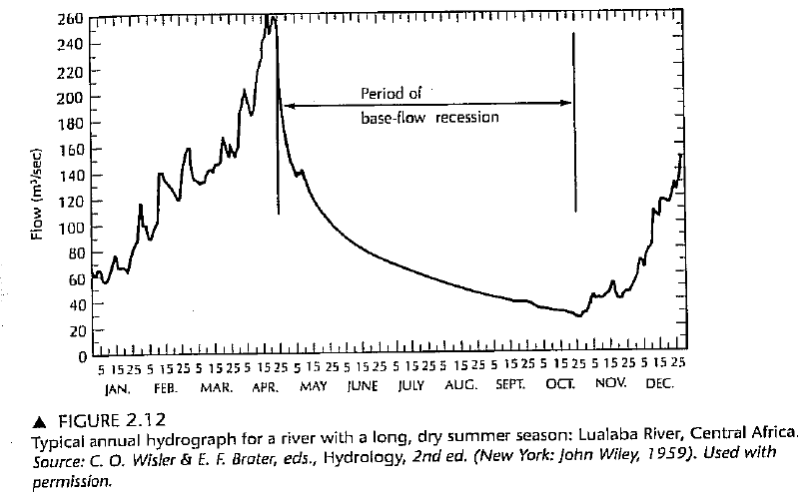
Stream Hydrographs – Baseflow Recessions
Baseflow is is the portion of streamflow that comes from subsurface flow
Baseflow recession in a stream occurs when groundwater feed to a stream decreases

Slide 26
Stream Hydrographs – Baseflow Recessions
Complex thing that depends on lots of characteristics in a watershed (topography, drainage, soils +geology)… but often the equation is simple
River is basically a drain collecting all the water from the aquifer. Thus given the above formula over a time from t=0 to t=T, how much water will drain from the aquifer?
Now if we let it drain forever (T=infinity) this would tell us how much water was in the aquifer. How much is this?

Slide 27
Stream Hydrographs – Baseflow Recessions
River is basically a drain collecting all the water from the aquifer. Thus given the above formula over a time from t=0 to t=T, how much water will drain from the aquifer?
Now if we let it drain forever (T=infinity) this would tell us how much water was in the aquifer. How much is this?

Slide 28
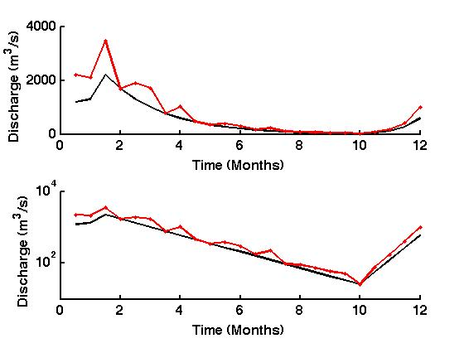
Sample Problem – How do we estimate a, the decay rate?
Determine a for the following base flow recession curve

Slide 29
Sample Problem – How do we estimate a, the decay rate?
Determine a for the following base flow recession curve
Matlab – measure from slope
Or calculate t₁, the time it takes for the flow to fall to 1/10 of its value
a=2.3/t₁

Slide 30
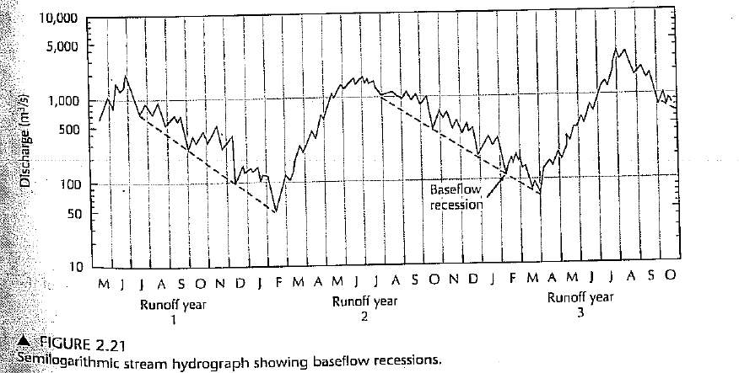
Ok – now this is what flow in a stream might look like
We have a wet season when it rains, recharging the aquifer..
We have a dry season when the river flows, draining the aquifer, which is not being replenished
At the end of the dry season it rains again
See curve above
Can you from a figure like this calculate how much water was added to the aquifer?

Slide 31
Ok – now this is what flow in a stream might look like
How about this?
Calculate the amount of water in the aquifer at the end of the recession
Calculate the amount of water at the beginning of the next recession
The difference between the two must be what was added.

Slide 32
Determining Ground-Water Recharge from Baseflow
Seasonal Recession Method
Find time t₁ which is how long it takes for flow to drop from Q₀ to Q₀/10

Slide 33
Determining Ground-Water Recharge from Baseflow
Seasonal Recession Method
Find time t₁ which is how long it takes for flow to drop from Q₀ to Q₀/10
Find V_{tp}^{(i)}, the volume of potential gw discharge
i=1 -> season 1
i=2 -> season 2
Apply algorithm to this figure

Slide 34
Determining Ground-Water Recharge from Baseflow
Seasonal Recession Method
Find time t₁
Find V_{tp}^{(i)},
Calculate potential baseflow V_{t} at time t, the end of the recession

Slide 35
Determining Ground-Water Recharge from Baseflow
Seasonal Recession Method
Find time t₁ which is how long it takes for flow to drop from Q₀ to Q₀/10
Find V_{tp,} the volume of potential gw discharge for season 1 and 2
Calculate potential baseflow V_{t} at time t, the end of the recession
Recharge= V_{tp}(season 2)- V_{t}(season 1) – amount of water in aquifer at beginning of season 2 – what was left at end of season1

Slide 36
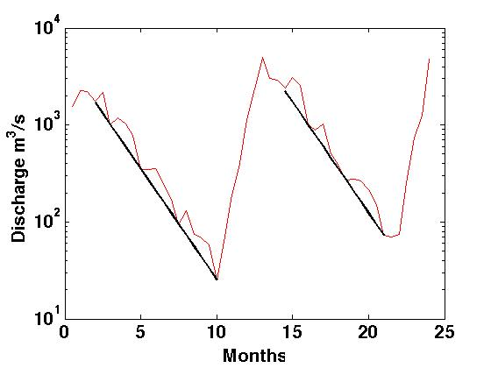
Sample Problem
Using the seasonal recession method estimate the ground-water recharge between the end of the first baseflow recession and the the start of the second one
Matlab

Slide 37
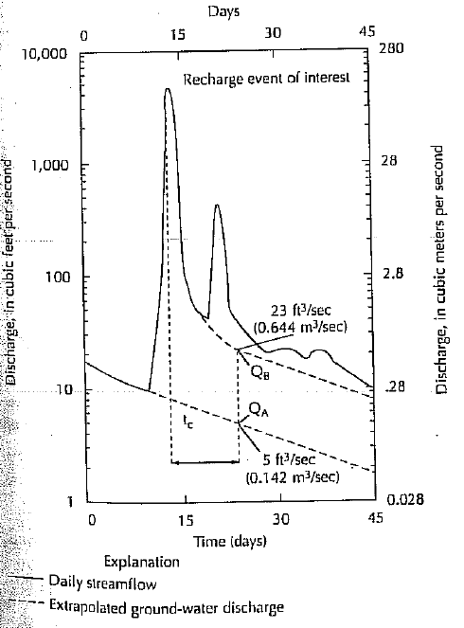
Determining Ground-Water Recharge from Baseflow
Recession Curve Displacement
During a baseflow recession there is a big storm event that recharges the aquifer (just like we had two weeks ago).
Recession curve looks like on right.
How much recharge was added to the aquifer?

Slide 38
Determining Ground-Water Recharge from Baseflow
Recession Curve Displacement
Physically ask:
How much water would be in aquifer if no recharge had happened?
How much water is in aquifer given that recharge happened?
Difference=Recharge
So – look at Q_{B} and Q_{A} on plot

Slide 39
Determining Ground-Water Recharge from Baseflow
Recession Curve Displacement
Find t₁ – as before
Compute t_{c}=0.2144t₁
t_{c} is the characteristic time after the peak of the storm event where the system returns to behaving as in a normal baseflow recession.

Slide 40
Determining Ground-Water Recharge from Baseflow
Recession Curve Displacement
Find t₁
Compute t_{c}=0.2144t₁
Locate time t_{c} after peak
Extrapolate recession A and B to find Q_{A} and Q_{B} at t_{c}
Apply equation
Any clue where this comes from?

Slide 41
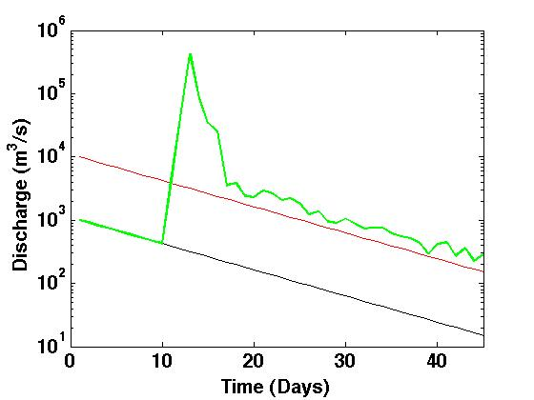
Sample Problem
Using the recession Curve Displacement Method find the recharge that caused the displacement in the baseflow recession curve depicted in the figure
Matlab

Slide 42
Open Channel Flow – Manning Equation
Imperial Units
V (ft/s)– average velocity
R (ft)- hydraulic radius (ratio of cross area to wetted perimeter)
S (ft/ft) - energy gradient
n – Manning roughness coefficient
Metric Units
V (m/s)– average velocity
R (m)- hydraulic radius (ratio of cross area to wetted perimeter)
S (m/m) - energy gradient
n – Manning roughness coefficient
a
b

Slide 43
Manning Roughness Coefficient
Stream Type | n
Mountain stream with rocky bed | 0.04-0.05
Winding Natural Stream with weeds | 0.035
Natural stream with little vegetation | 0.025
Straight, unlined earth channel | 0.02
Smoothed concrete | 0.01
Entirely empirical so be very careful with units!!!

Slide 44
Sample Problem
A mountain stream with a rocky bed roughly speaking has vertical sides of depth 20cm and a width of 50 cm. The bottom of the channel drops 2m over a distance 10 m. What is its discharge?

